Slide 1
Location
Meningitis: inflammation of subarachnoid space (between brain and skull) or spinal fluid
Encephalitis: inflammation of the brain itself
Two main microbiologic tests that should be obtained include a
Gram stain
Culture of the CSF.
Antigen Detection Tests (Latex Agglutination, latex fixation, enzyme immunoassay (EIA) – good b/c its faster than culture
Cause of CNS infection
Strep pneumoniae 47%
Neisseria meningitidis 25%
Hemophilus influenzae 7% because of Hib vaccine
Listeria Monocytogenes
Classic signs and symptoms the classic triad)
Fever
nuchal rigidity (stiff neck)
altered mental status
Three primary goals of treatment in meningitis include
Eradication of infection,
Amelioration of signs and symptoms, and
Prevention of the development of neurologic sequelae, such as seizures, deafness, coma, and death.
Monitor
Fever
Clinical Symptoms: Irritability
Blood cultures
WBC, differential, protein, glucose
CSF tap

Slide 2
Abnormal cerebrospinal fluid (CSF) findings
CSF
Type | Normal | Bacterial | Viral | Fungal | TB
WBC | < 5 | 1000 – 5000 | 100 – 1000 | 40 – 400 | 100 – 500
Differential | Monocyte > 90 | polymorphonuclear leukocytes (PMN) > 80 | Monocyte & Lymphocytes > 50 | Lymphocyte > 50 | Monocyte & Lymphocytes > 80
Protein | < 50 | 100 – 500 | 30 – 150 | 40 – 150 | 40 – 150
Glucose | 50 – 66% | < 40% (decrease) | 30 – 70% | 30 – 70% | 30 – 70%
The differential totals the number of each WBC type (neutrophils, lymphocytes, monocytes, eosinophils and basophils) and determines if the cells are present in normal proportion to one another

Slide 3
Treatment of Meningitis
Age Empiric Treatment | Drug | Possible cause
1 month | Ampicillin + Cefotaxime or Ampicillin + Ceftriaxone | Strep, Listeria, Gram neg enterics
1 month – 60 y/o | Vanco + Cefotaxime or Vanco + Ceftriaxone | Strep pnuemo, meningitidis, H. influenzae
> 60 y/o | Ampicillin + Vanco + Cefotaxime or Ampicillin + Vanco + Ceftriaxone | Strep pnuemo Listeria Monocytogenes Gram Negative
Head Trauma or CSF shunt | Vanco + cefpime/ceftaz/meropenm | Possible pseudo
Gram +
Gram -
Strep Pneumo
Listeria
monocytogenes
Neisseria
meningitis
Haemophilus
Influenzae
Drug | Use next if
Penicillin G If MIC < 0.6 | Allergy Resistant
Vanco + Cefo
Drug | Use next if
Penicillin G | Allergy
Ampi + Gentamycin
Drug | Use next if
Penicillin G | Allergy
Cefotaxime
Drug | Use next if
Ampicillin | Resist
Cefotaxime
Tx for 2 weeks
Tx for 2 weeks
Tx for 1 week
Tx for 1 week
Notes:
Penicillin may be used for drug-susceptible isolates with MICs of 0.06 mg/L or less

Slide 4
Dexamethasone as Adjunctive Treatment for Meningitis
In addition to antibiotics, dexamethasone has become a commonly used therapy in the treatment of meningitis. Corticosteroids inhibit the production of TNF and IL-1, both potent pro-inflammatory cytokines.
Whether or not steroids are beneficial in meningitis caused by penicillin-resistant S. pneumoniae, N. meningitidis, and group B streptococci is unclear at this time.
Who:
infants and children 2 months or older
or
Those with H. influenzae (only)
Dose: 0.15 mg/kg q6h for 4 days before or during antibiotic therapy

Slide 5
Prophylaxis: Treat surrounding members and Vaccines
Cause | When to worry | Prophylaxis treatment | Dose | Duration
N Meningitidis | Close contact | Rifampin | 600 mg BID | 2 days
S Pneumoniae
H. influenzae | Contact with respiratory sections | Rifampin | 20 mg/kg daily Max 600 mg | 4 days
Listeria Monocytogenes | Neonates Old age immunocompromised
 | Hemophilus Influenza B | Pneumococcal | Meningococcal
 | Hib (several vaccines marketed
Primary Series | 2,4,6,12-15 months | PCV-13 | MCV4
 |  | 2,4,6,12-15 months | 11-12 yr repeat at 16 yr
Adults | Anatomic or functional asplenia | PPSV | MCV4
 |  | 65 yr
 |  | Smoker | Asplenia,
 |  | Chronic diseases
 |  | Asplenia
 |  | Cochlear Implant
 |  | immunosuppressive

Slide 6
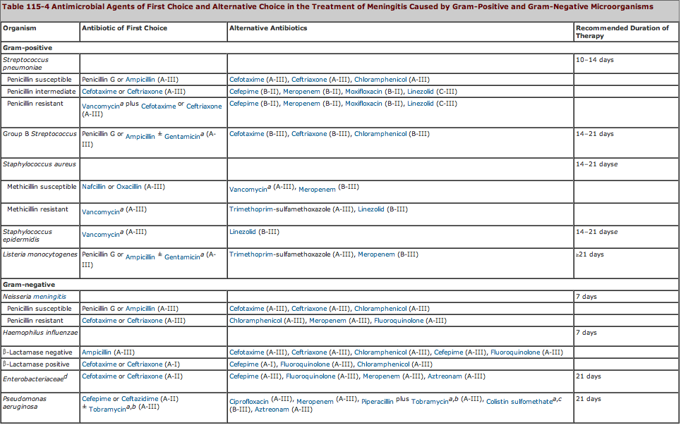

Slide 7
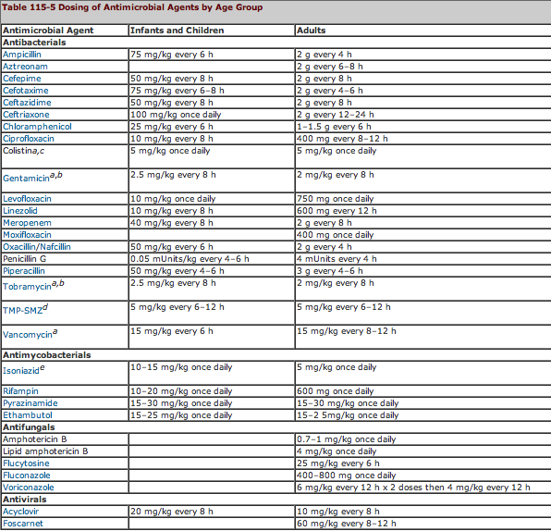
IV

Slide 8
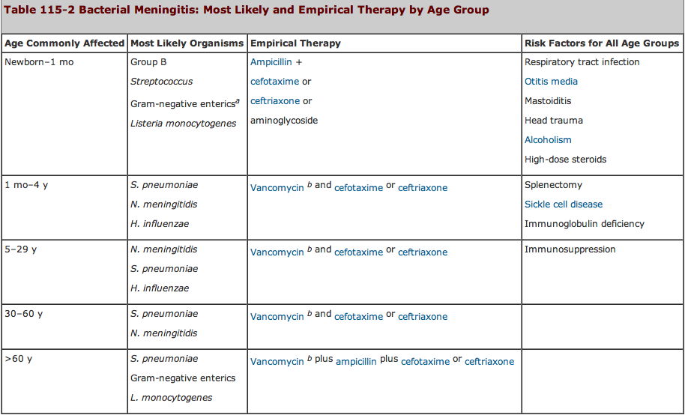

Slide 9
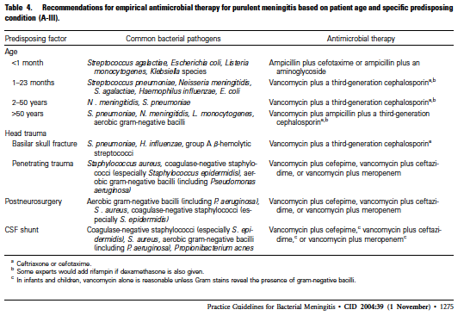

Slide 10
Dosing of Antimicrobial Agents by Age Group
Antimicrobial Agent | Infants and Children | Adults
Ampicillin | 75 mg/kg every 6 h | 2 g every 4 h
Aztreonam |  | 2 g every 6–8 h
Cefepime | 50 mg/kg every 8 h | 2 g every 8 h
Cefotaxime | 75 mg/kg every 6–8 h | 2 g every 4–6 h
Ceftazidime | 50 mg/kg every 8 h | 2 g every 8 h
Ceftriaxone | 100 mg/kg once daily | 2 g every 12–24 h
Chloramphenicol | 25 mg/kg every 6 h | 1–1.5 g every 6 h
Ciprofloxacin | 10 mg/kg every 8 h | 400 mg every 8–12 h
Colistina | 5 mg/kg once daily | 5 mg/kg once daily
Gentamicin | 2.5 mg/kg every 8 h | 2 mg/kg every 8 h
Levofloxacin | 10 mg/kg once daily | 750 mg once daily
Linezolid | 10 mg/kg every 8 h | 600 mg every 12 h
Meropenem | 40 mg/kg every 8 h | 2 g every 8 h
Moxifloxacin |  | 400 mg once daily
Oxacillin/Nafcillin | 50 mg/kg every 6 h | 2 g every 4 h
Penicillin G | 0.05 mUnits/kg every 4–6 h | 4 mUnits every 4 h
Piperacillin | 50 mg/kg every 4–6 h | 3 g every 4–6 h
Tobramycin | 2.5 mg/kg every 8 h | 2 mg/kg every 8 h
TMP-SMZ | 5 mg/kg every 6–12 h | 5 mg/kg every 6–12 h
Vancomycin | 15 mg/kg every 6 h | 15 mg/kg every 8–12 h

Slide 11
Antimycobacterials Infants and Children |  | Adults
Isoniazide | 10–15 mg/kg once daily | 5 mg/kg once daily
Rifampin | 10–20 mg/kg once daily | 600 mg once daily
Pyrazinamide | 15–30 mg/kg once daily | 15–30 mg/kg once daily
Ethambutol | 15–25 mg/kg once daily | 15–2 5mg/kg once daily
Antifungals Infants and Children |  | Adults
Amphotericin B |  | 0.7–1 mg/kg once daily
Lipid amphotericin B |  | 4 mg/kg once daily
Flucytosine |  | 25 mg/kg every 6 h
Fluconazole |  | 400–800 mg once daily
Antivirals | Infants and Children | Adults
Acyclovir | 20 mg/kg every 8 h | 10 mg/kg every 8 h
Foscarnet |  | 60 mg/kg every 8–12 h

Slide 12
Therapeutic levels in CSF with or without inflammation
Choramphenicol | Pyrazinamide
Cycloserine | Rifampin
Ethionamide | Sulfonamides
Isoniazid | Trimethoprim
Metronidazole
Therapeutic levels in CSF WITH inflammation of meninges
Acyclovir | Ganciclovir
Ampicillin ± sulbactam | Imipenem
Aztreonam | Levofloxacin
Carbenicillin | Linezolid
Cefotaxime | Meropenem
Ceftazidime | Mezlocillin
Ceftizoxime | Moxifloxacin
Ceftriaxone | Nafcillin
Cefuroxime | Ofloxacin
Ciprofloxacin | Penicillin G
Colistin | Piperacillin
Daptomycin | Pyrimethamine
Ethambutol | Quinupristin/dalfopristin
Fluconazole | Ticarcillin ± clavulanic acid
Flucytosine | Vancomycin
Foscarnet | Vidarabine

